Slide 1

Assign Title: The Origin of Birds
AMERICAN INTERNATIONAL
UNIVERSITY-BANGLADESH
Faculty of Engineering
Student Id: 20-43633-2
Name: Tanjil Hasan Sakib
Course Title: Course Code: 01478
Semester: Summer (2019-20) Section: B1
Degree Program: BSc [CSE]
Course Teacher:
Date of Submission: 08/08/2020

Slide 2
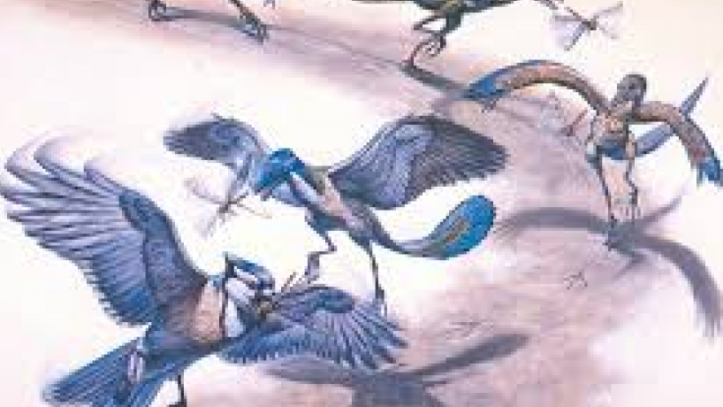
The Origin of Birds
Technical name for birds is Aves, and “avian” means “of or concerning birds”

Slide 3
Research
Scientific investigation in 1859
Discovery of fossilized feather in 1860.

Slide 4
It’s Origin
Believed to be evolved from reptiles
Hollow bones
Archaeopteryx characteristics.
strong legs and rounded wings indication.

Slide 5
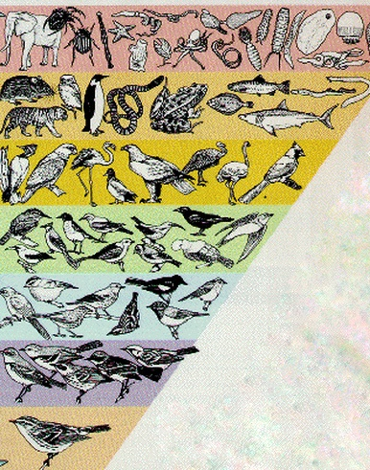
ICZN Classification of Birds
Kingdom: Animalia
Phylum: Chordata
Sub-Phylum: Vertebrata
Class: Aves

Slide 6
Characteristics of Birds
Feathers
Warm-blooded (also in mammals)
Specialized lungs & air-sacs
Hollow bones
Toothless beaks
Large brain

Slide 7
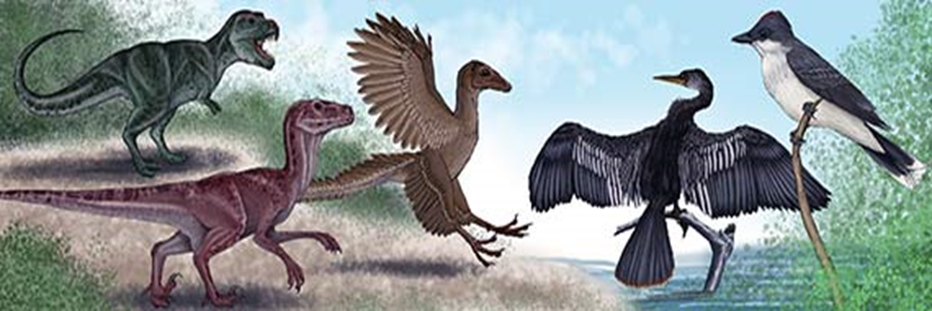
Conclusion
Long Journey of its evolution

